Slide 1


Design Industries Analysis
DES3061 Design Profession and Practice – Project 1 FS113002D/C Liu Wai Leung

Slide 2




39

Slide 3




Slide 4


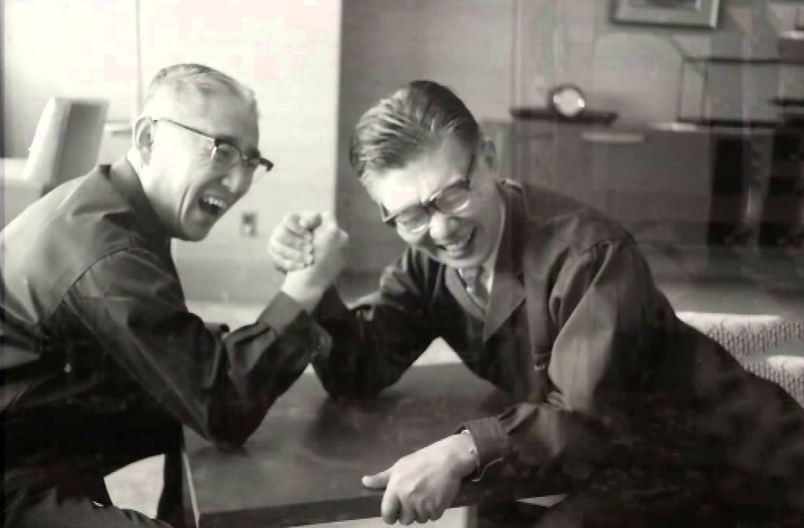
Akio Morita
Masaru Ibuka

Slide 5
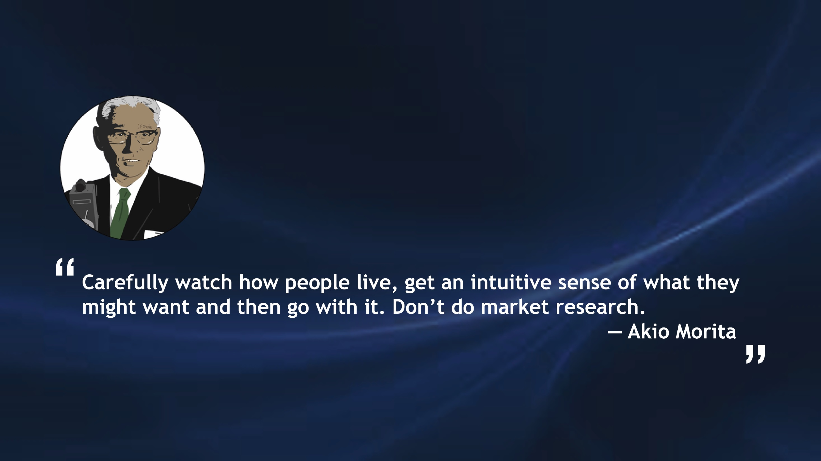

Slide 6

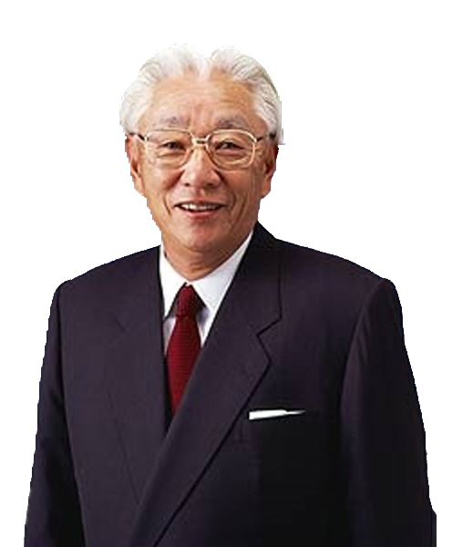
Akio Morita was born in 1921 in the city of Nagoya, Japan, where his family had been sake brewers since the sixteenth century. It was expected that Akio, the oldest son, would step into the business but the boy was more interested in electronics than in brewing. He studied Physics at Osaka Imperial University and graduated in 1944.
Two years later, he and his partner, Masaru Ibuka, whose decided to form a business together. They founded Tokyo Telecommunications Engineering Corporation with approximately 20 employees and initial capital of ¥190,000. The main objective of the company was to design and create innovative products which would benefit the people. Many products that have been launched throughout Sony's history can be credited to Morita's creativity and innovative ideas. His ideas gave birth to totally new lifestyles and cultures, and this is evident from such products as the Walkman and the video cassette recorder.
In 1958, the company's drive to expand its business globally is apparent in the decision to change its corporate name to Sony. A decision that was not well received either within or outside the company because it had already become widely known.
He died of pneumonia in Tokyo in 1999, at the age of 78. His legacy lives on in the company he founded, the company that continues to be one of the world’s most renowned manufacturers of consumer electronics.

Slide 7
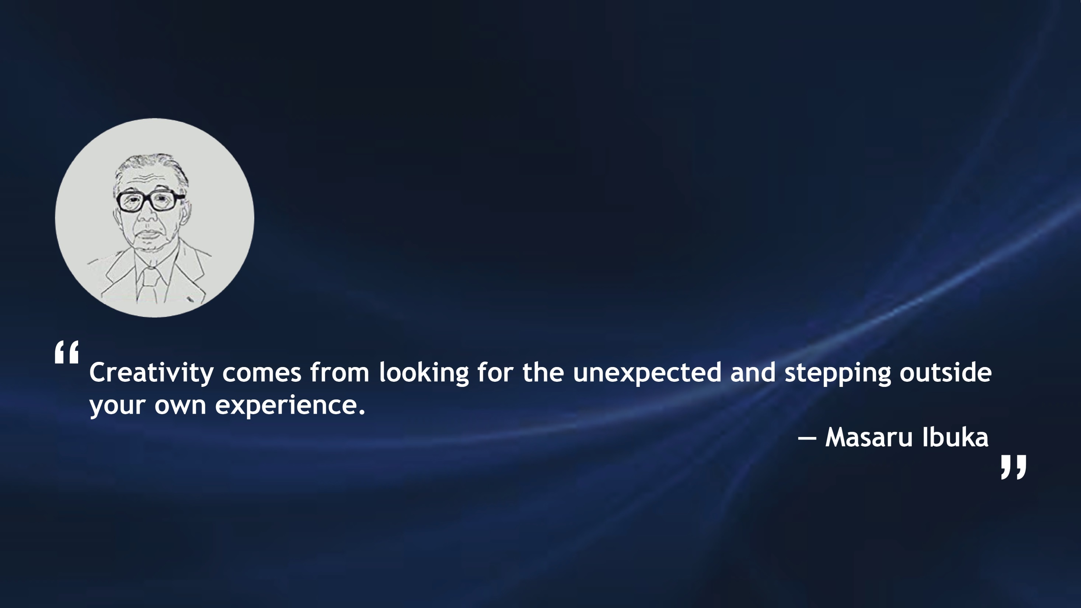

Slide 8

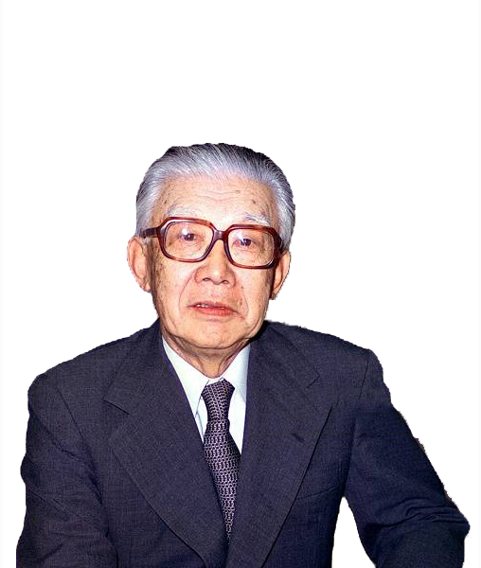
Masaru Ibuka was born in 1908 in Nikkō City, Japan.
After graduating from the Faculty of Science and Engineering at Waseda University in 1933, he entered Photo Chemistry Laboratory Company Limited, which processed movie film. He later served in the Imperial Japanese Navy during World War II, being a member of the Imperial Navy Wartime Research Committee.
In 1946, he left the company, and co-founded Tokyo Telecommunications Engineering Corporation along with Akio Morita, afterwards in 1958 renamed Sony Corporation. They developed various new products which opened up new vistas of the future. Ibuka was instrumental in securing the licensing of transistor technology to Sony from Bell Labs in the 1950s, thus making Sony one of the first companies to apply transistor technology to non-military uses. For example, TR-55, television, videocassette recorder (VCR) and Walkman.
He served as president of Sony from 1950 to 1971, and then served as chairman of Sony between 1971 and 1976. He received an honorary doctorate from Waseda University in 1979. Named a Person of Cultural Merit in 1987, he was also awarded the Order of Culture in 1992 and the Grand Cordon of the Order of the Paulownia Flowers, first class, in 1997. Meanwhile, he died at home in Tokyo, at the age of 89. The cause of death was heart failure.

Slide 9

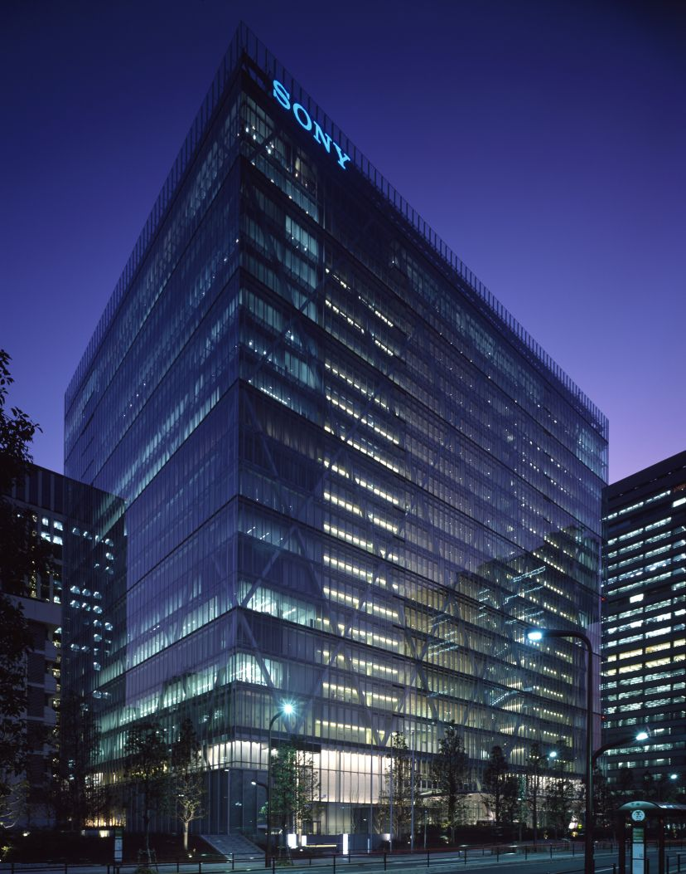
Sony Corporation (Tokyo Telecommunications Engineering Corporation for the predecessor), incorporated on May 7, 1946, is engaged in the development, design, manufacture and sale of various kinds of electronic equipment, instruments and devices for consumer, professional and industrial markets, as well as game consoles and software.
The Company's segments include Mobile Communications, Game & Network Services, Imaging Products & Solutions, Home Entertainment & Sound, Semiconductors, Component, Films, Music, Financial Services and All Other. It is engaged in the production, acquisition and distribution of motion pictures and television programming and the operation of television and digital networks. It is also engaged in the development, production, manufacture and distribution of recorded music and the management and licensing of the words and music of songs. It is also engaged in various financial services businesses, including life and non-life insurance operations, through its Japanese insurance subsidiaries and banking operations through a Japanese banking subsidiary.
Sony City

Slide 10

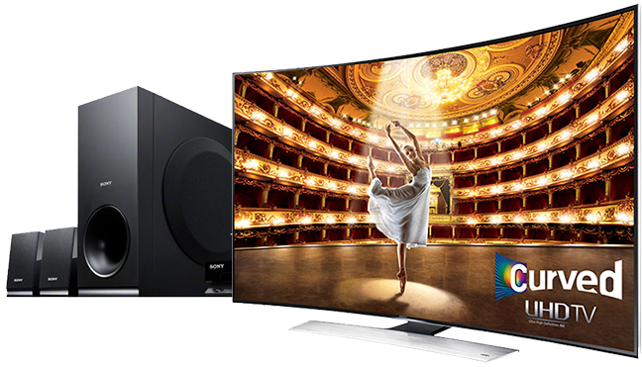
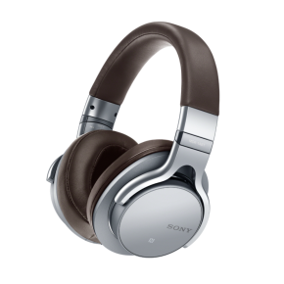
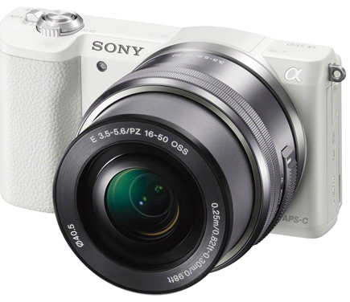
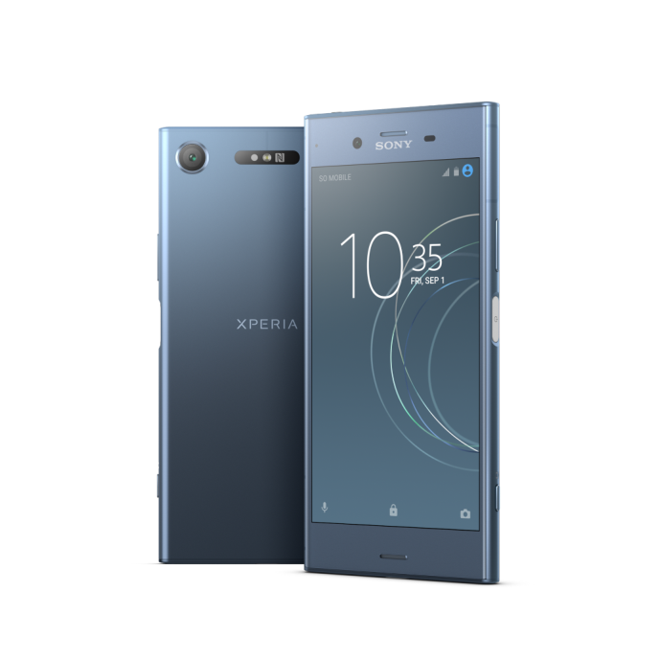
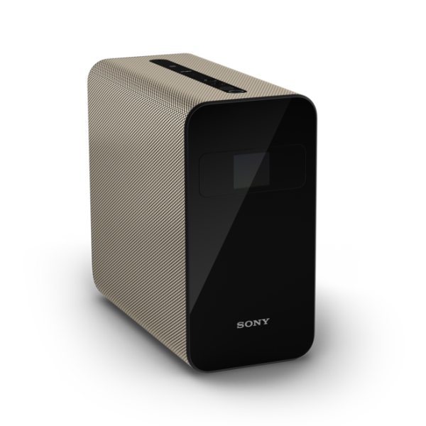
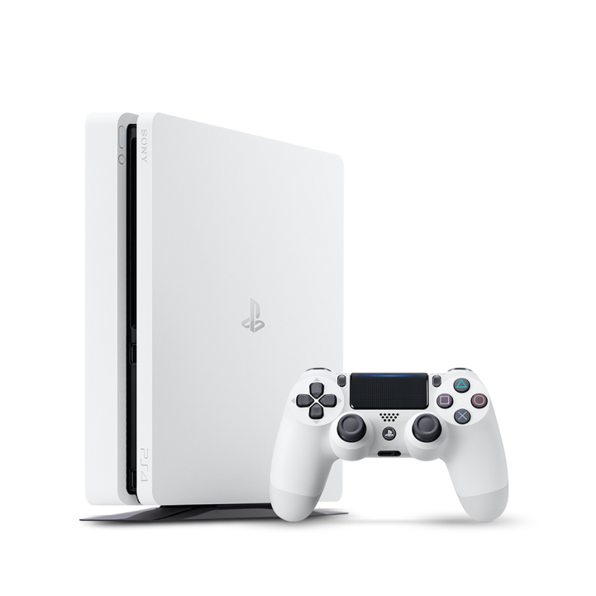
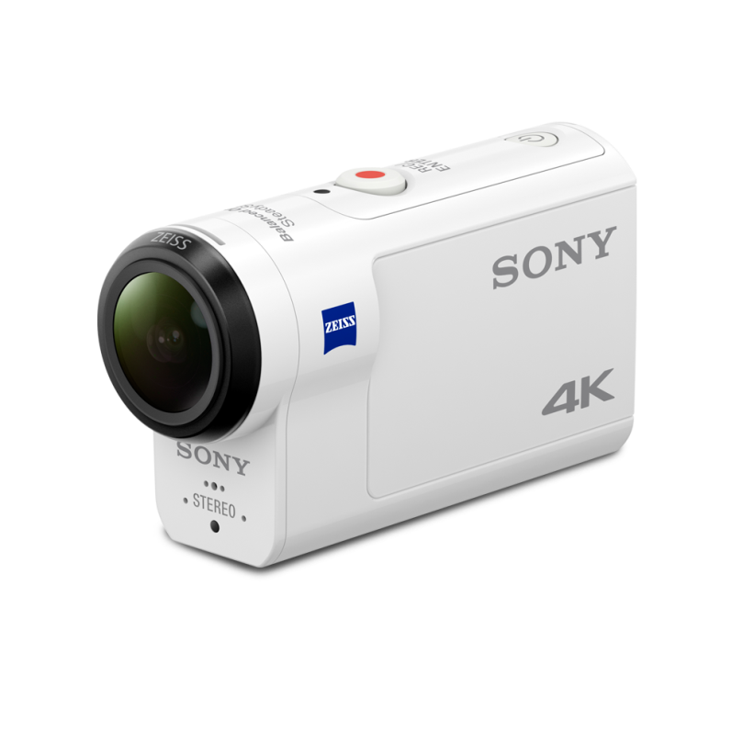
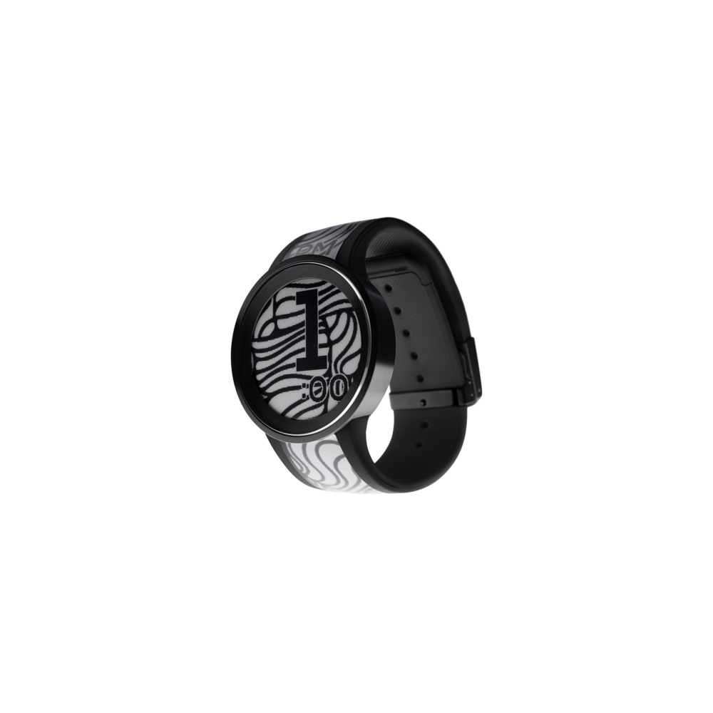

Televisions & Home Cinema
Audio
Cameras
Smart Products
PlayStation
Video Cameras
Fashion Entertainments
Other

Slide 11

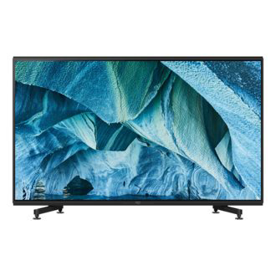
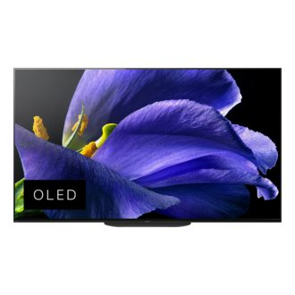
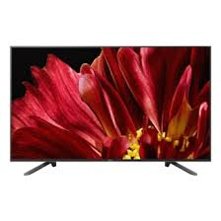

Z9G | MASTER Series | LED | 8K | High Dynamic Range (HDR) | Smart TV
XBR Z9G Series
215 cm (85'')|248 cm (98")
Z9G | MASTER Series | OLED | 4K Ultra HD| High Dynamic Range (HDR) | Smart TV
XBR A9G Series
139 cm (55")|164 cm (65")|
195 cm (77")
Z9F | MASTER Series | LED | 4K Ultra HD| High Dynamic Range (HDR) | Smart TV
XBR A9F Series
164 cm (65")|189 cm (75”)
A1 | OLED | 4K Ultra HD | High Dynamic Range(HDR) | Smart TV
A1E
139 cm (55")|164 cm (65")|
195 cm (77")

Slide 12
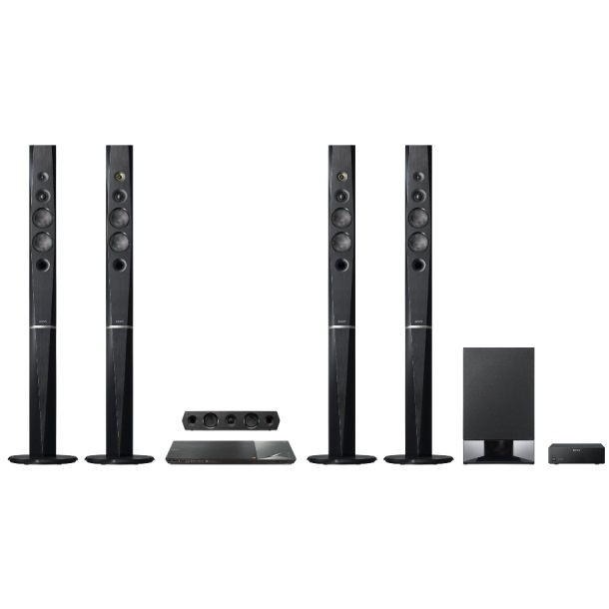
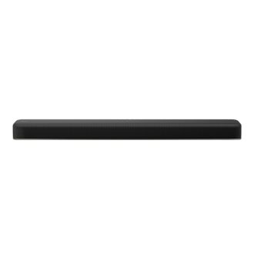
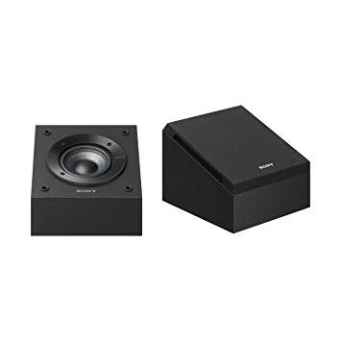
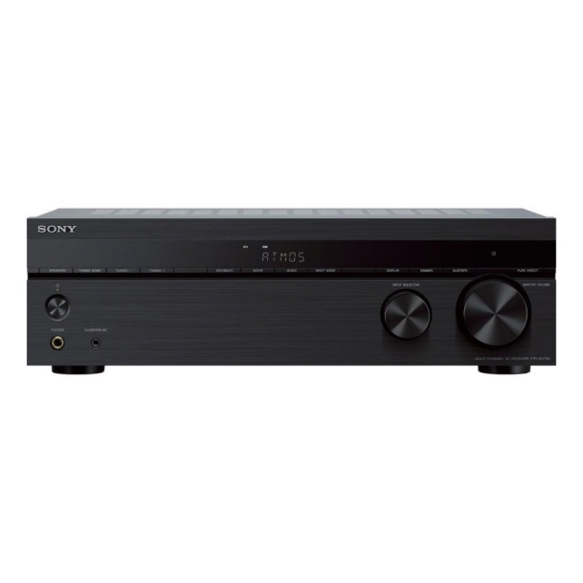
Blu-ray Home Cinema System with Bluetooth
BDV-N9200W / N9200WL
White|Black
2.1ch Dolby Atmos®/DTS:X® Single Sound Bar with built-in subwoofer | HT-X8500
HT-X8500
Dolby Atmos Enabled Speakers
SS-CSE
7.2ch Home Cinema AV Receiver
STR-DN1060

Slide 13


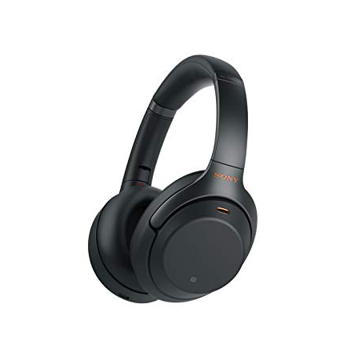
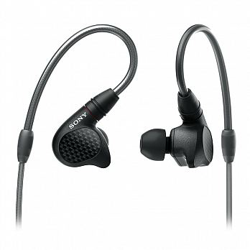
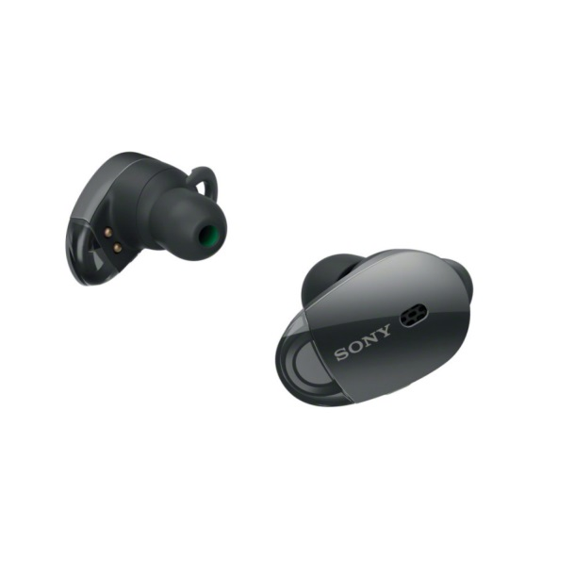
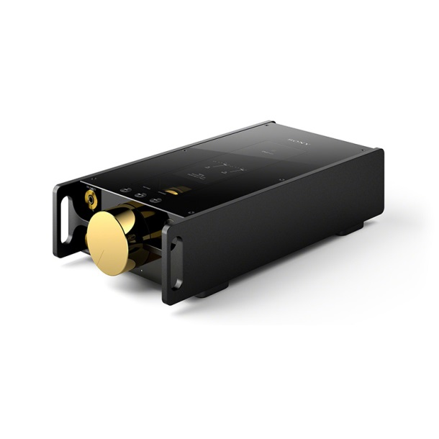
WH-1000XM3 Wireless Noise Cancelling Headphones
WH-1000XM3
Silver|Black
IER-M9 In-ear Monitor Headphones
IER-M9
1000X Wireless Noise Cancelling Headphones
WF-1000X
Gold|Black
DMP-Z1 Digital Music Player Signature Series
SDMP-Z1

Slide 14
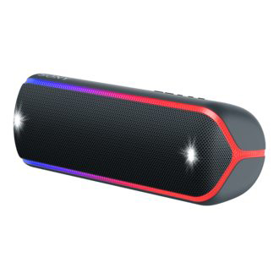
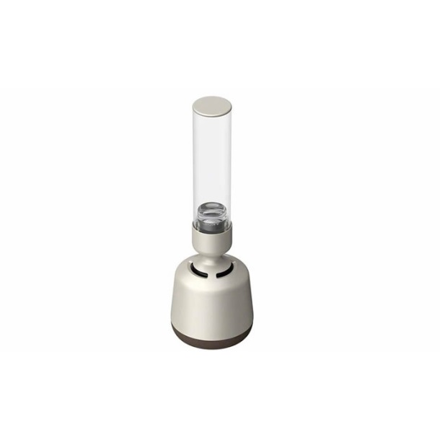
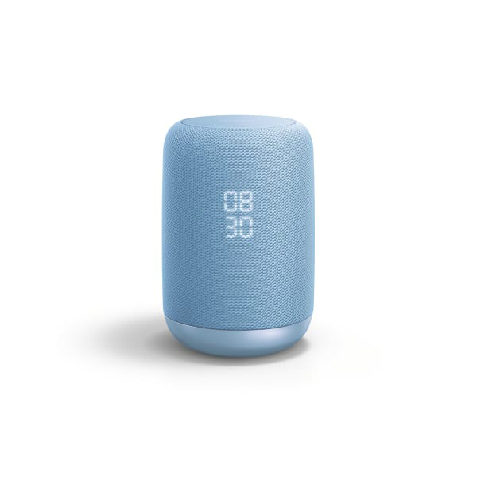
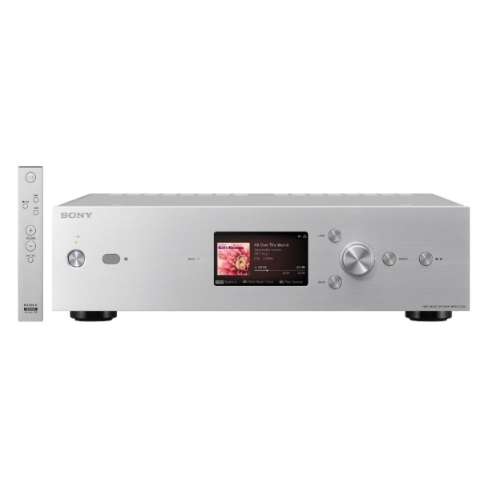

XB32 EXTRA BASS™ Portable BLUETOOTH® Speaker
SRS-XB32
Red|Green|Blue|Gray|Black
LSPX-S2 Glass Sound Speaker
LSPX-S2
S50G Google Assistant Built-in Wireless Speaker
LF-S50G
Sony$×$Google
Blue|White|Black
High-Resolution Audio HDD Player
HAP-Z1ES

Slide 15


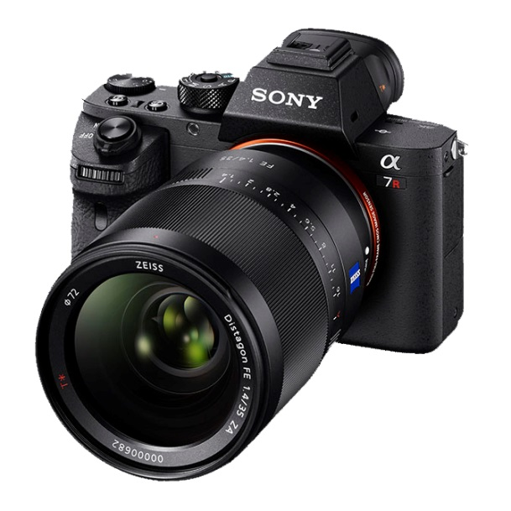
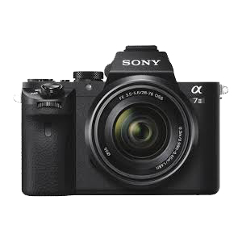
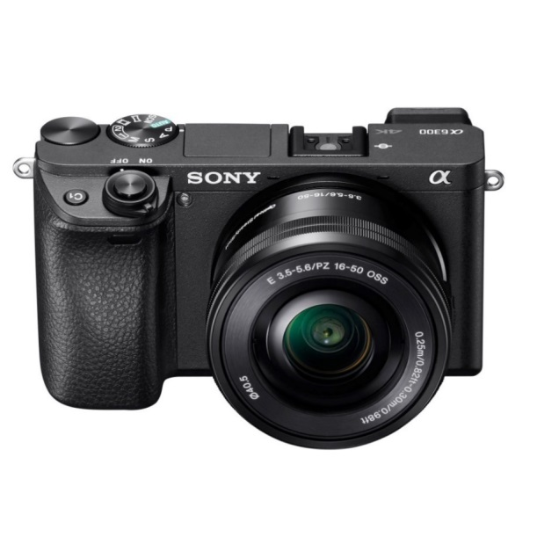
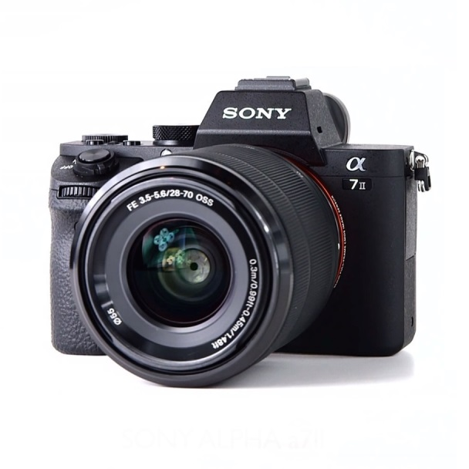
α7R II with back-illuminated full-frame image sensor
ILCE-7RM2
ISO 50-102400
α7 III with 35mm full-frame image sensor
ILCE-7M3 / ILCE-7M3K
α6300 E-mount camera with APS-C Sensor
ILCE-6300 / ILCE-6300L
α7 II E-mount Camera with Full Frame Sensor
ILCE-7M2 BODY / KIT
ISO 50-25600

Slide 16


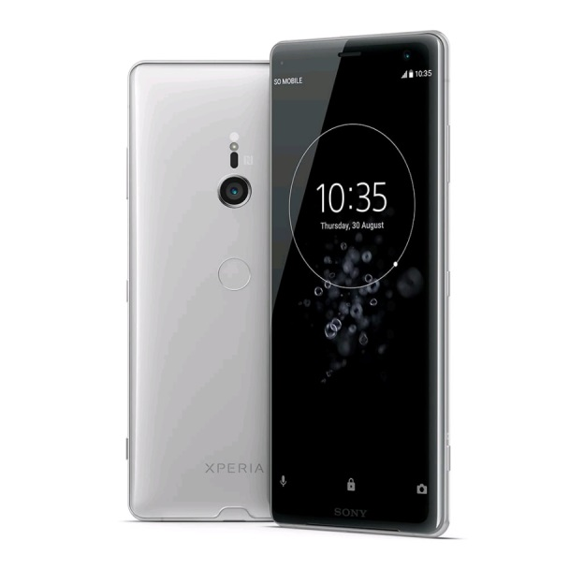
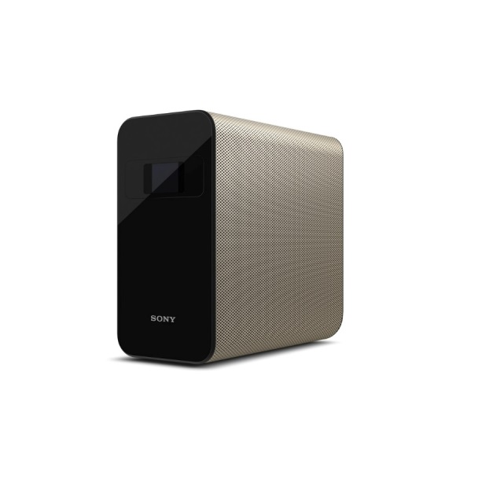
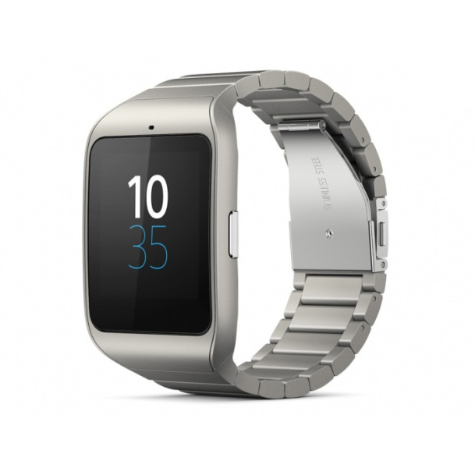
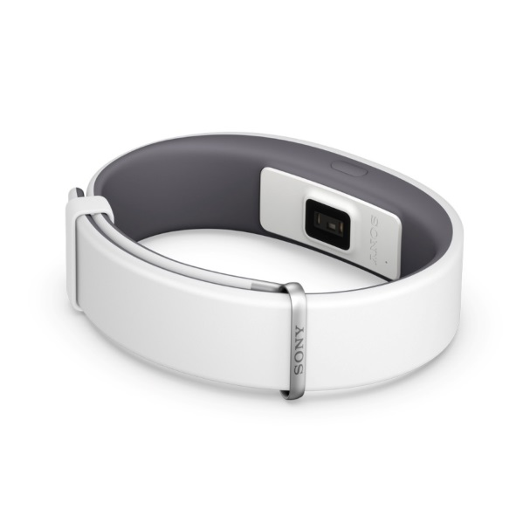
Xperia XZ3
Black|White Silver|Forest Green|
Bordeaux Red
Xperia Touch
SmartWatch 3 SWR50
Life at a glance
Stainless Steel|Black|Yellow|
Leather Brown|Leather Black
SmartBand 2
Find your balance in life
White|Black

Slide 17


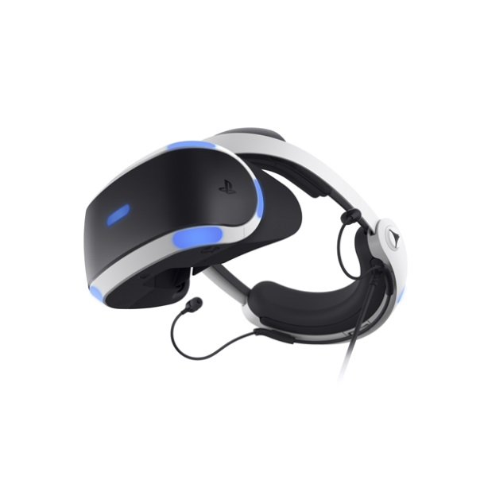
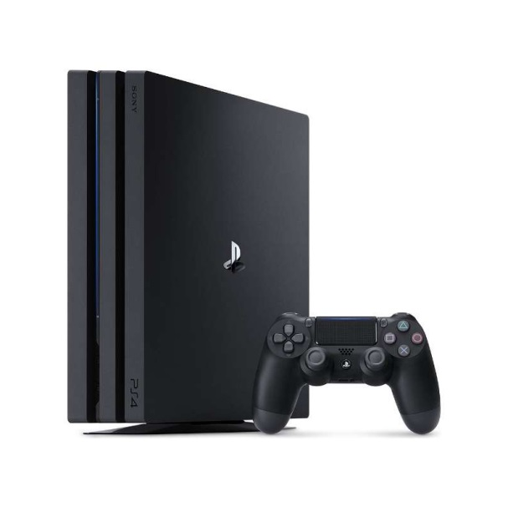
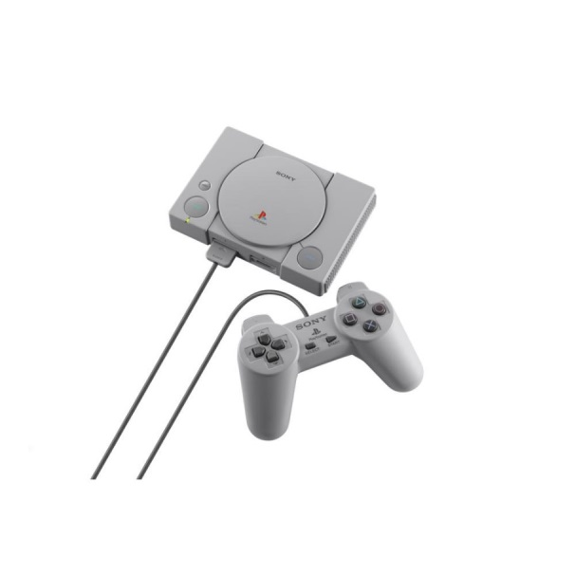
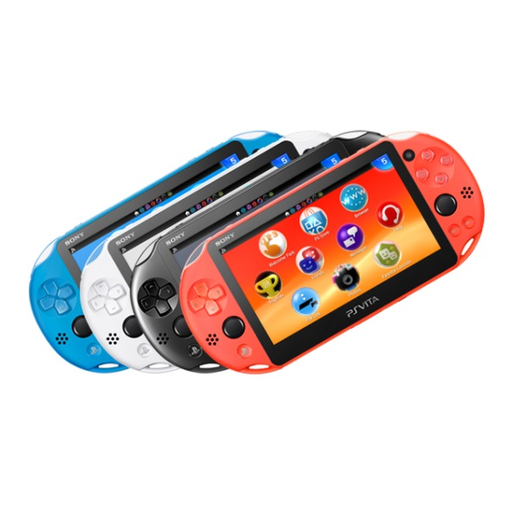
PlayStation VR
CUH-ZVR2
PlayStation 4 Pro Jet Black 2TB
CUH-7218C B01
PlayStation Classic
SCPH-1000RH
PlayStation Vita
PCH-2006 ZA24 / PCH-2006 ZA11 / PCH-2006 ZA22 / PCH-2006 ZA23
Neon Orange|Black|White|Aqua Blue

Slide 18


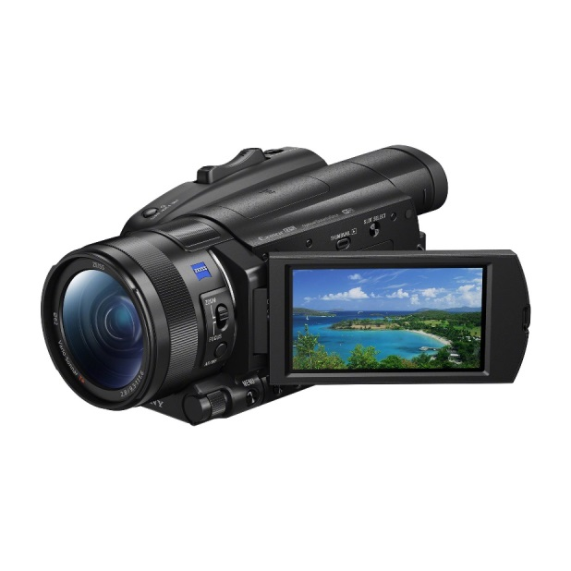
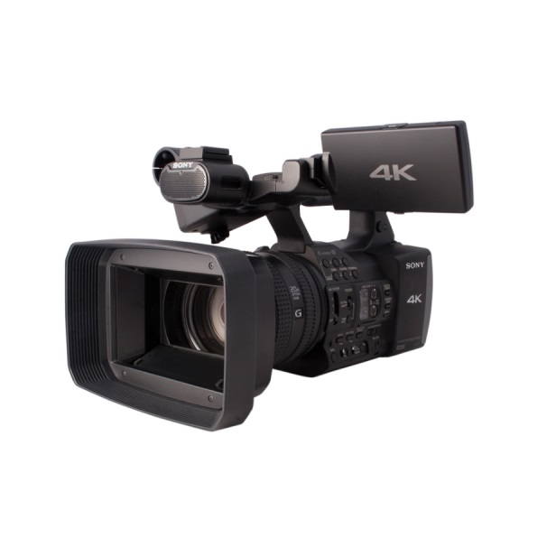
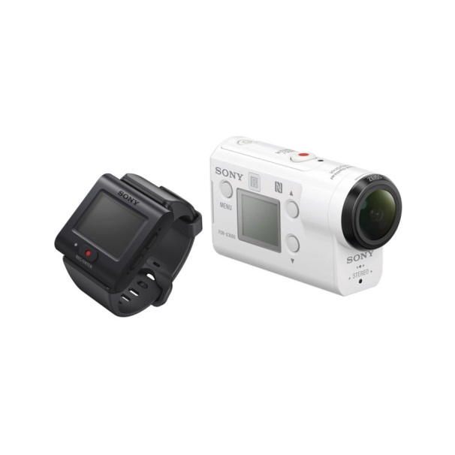
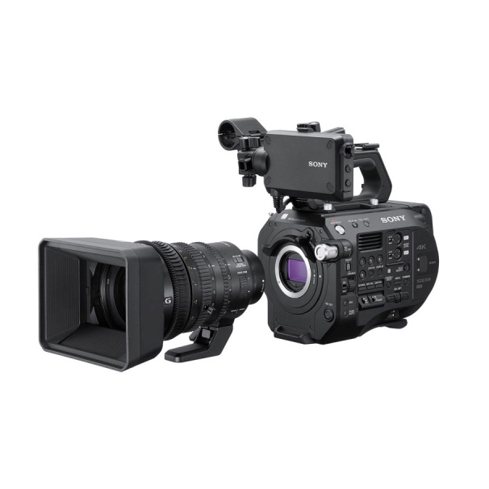
FDR-AX700 4K HDR Camcorder
FDR-AX700
AX1E 4K Professional Handycam®
FDR-AX1E
FDR-X3000 4K Action Cam with Wi-Fi & GPS
FDR-X3000 / FDR-3000R
FS7 II Handheld Camcorder
PXW-FS7M2 / PXW-FS7M2K

Slide 19

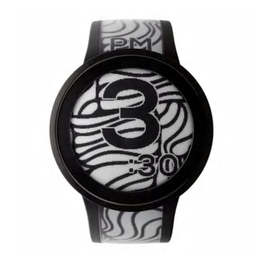
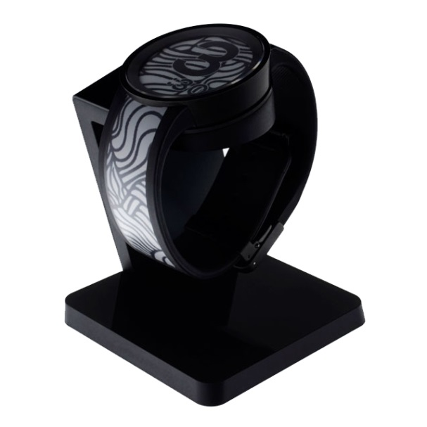
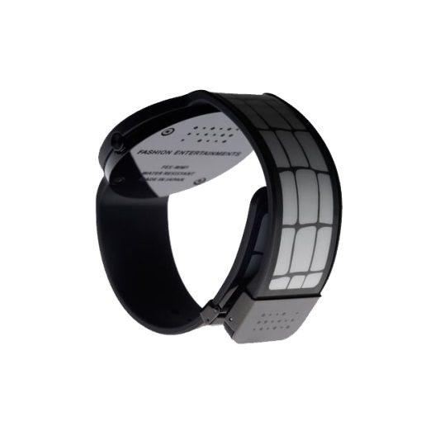
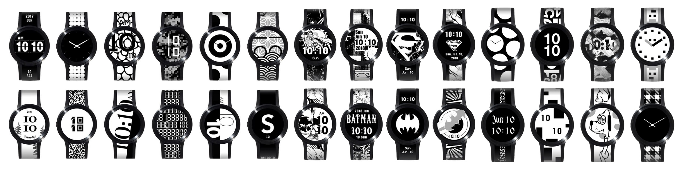
FES Watch U e-paper fashion watch
FES-WA1
Silver|Black

Slide 20

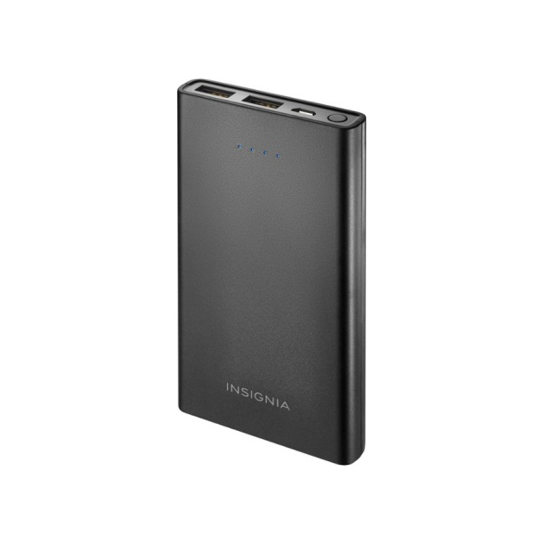



Portable Charger (10,000 mAh)
CP-V10B
Blue|White|Black
Car Charger with dual USB-C™ and USB-A output
CP-CAD3M2
External SSD with USB Type-C™
SL-E Series
240GB|480GB|960GB
External Pocket Size Hard Drive
HD-SL SERIES
1TB|2TB

Slide 21




DLC-MB20 Mobile High-Definition Link Cable
DLC-MB20
Fast Charger UCH32C
Style Cover Stand SCSH70 for Xperia XZ3
Black|White Silver|Forest Green|
Bordealux Red
MCC-S40MD 4K Boom-Arm Mountable Video Camera
MCC-S40MD

Slide 22



Slide 23


Slide 24


Slide 25


Slide 26


Slide 27


Slide 28


Slide 29


The Sony is certainly one of the world’s most popular and instantly recognizable logos. It has undergone several modifications throughout the years.
The company’s name, “SONY”, originates from the Latin word “sonus”, meaning sound. Moreover, the words “sunny” and “sonny” hugely inspired the earliest Sony logo, which was registered as a trademark in 1955. The logo, however, started appearing on the company’s products two years later in 1957.
The current version of the Sony logo comprises of a simple wordmark which was first introduced in 1959. According to some branding experts, it is meant to “communicate strength and simplicity”. The Sony logotype experienced a few minor overhauls in 1961, 1962, 1969 and 1973, mostly upon the suggestions of Norio Ohga, the former president and chairman of Sony. Majority of these changes were implemented under the supervision of Sony designer Yasuo Kuroki and its chief of the design bureau, Akio Morita.
The company’s current slogan, “make.believe”, was adapted in 2009.

Slide 30


Sony’s corporate mission is to be “a company that provides customers with kando – to move them emotionally – and inspires and fulfills their curiosity.”
The mission highlights the importance of kando and what it does for customers. Sony’s mission statement has the following components︰
Provides customers with kando
Inspires and fulfills their curiosity
In its mission statement, Sony Corporation focuses on the concept of kando. Such focus aligns the corporate mission to the vision statement. To effectively apply the concept, the mission statement requires that Sony must develop products that evoke emotion that moves customers.
For example, the PlayStation attracts and retains customers through an emotional bond based on gaming experience. In relation, the second component of Sony’s mission statement focuses on what the business must do for customers. In this case, the company must inspire and fulfill customers’ curiosity.

Slide 31


With regard to its corporate vision, Sony states, “Our vision is to use our passion for technology, content and services to deliver kando, in ways that only Sony can.”
In this vision, emphasis is on the concept of kando. The following components are present in Sony Corporation’s vision statement︰
Deliver kando
Use our passion for technology, content and services
Ways that only Sony can
Sony’s vision statement introduces the concept of kando, which CEO Kazuo Hirai defines as “emotional involvement” or the “power to stimulate emotional response.” The concept is integrated in product development and innovation processes.

Slide 32


Dreams & Curiosity
Pioneer the future with dreams and curiosity.
Diversity
Pursue the creation of the very best by harnessing diversity and varying viewpoints.
Integrity & Sincerity
Earn the trust for the Sony brand through ethical and responsible conduct.
Sustainability
Fulfill our stakeholder responsibilities through disciplined business practices.

Slide 33


Curiosity
Our curiosity stems from a context of fun and excitement. Sony thrives on a culture of freedom and open-mindedness, and it is in this spirit of adventure that we provide a sense of wonder across the globe.
Empathy
Through a relentless process of considered refinement, we determine the distinct essence. Expressed in its clearest and most beautiful form, this essence symbolizes what we strive to achieve in all our design.
Integrity
Through a relentless process of considered refinement, we determine the distinct essence. Expressed in its clearest and most beautiful form, this essence symbolizes what we strive to achieve in all our design.
Ambition
In our quest for perfection, we strive to be outstanding with designs of unequivocal originality. A dynamic cultural mix of unique personalities and approaches sparks life into our products and best expresses Sony’s inventiveness.
Visionary
We have always been on the cutting edge, never being held back by fear of failure. By taking such an approach to design we give form to innovative concepts and bring them to fruition; creating new standards, that turn ideas into global benchmarks.

Slide 34



Slide 35




Slide 36




Slide 37



Slide 38



















High Price
Low Quality
High Quality
Low Price

Slide 39

Apple
High quality
High price
Highly featured and functional mobile devices and computers
Easy to use
Sony
High quality
High products manufacturer
High price
Premium brand
Google
High quality
High price
Solution-centric
Innovation
Socially responsible
Vast networks, deep knowledge
Samsung
High quality
High price
Provides best phones and appliances for every need and price range
LG
High quality
High price
Offers you more and sets you free for technology
ASUS
High quality
High price
“Lean thinking” to create the greatest value for consumers
Sharp
High quality
High price
Good customer service
Innovative consumer electronics
HTC
High quality
High price
Device which is helps in communication
serves as an entertainment device
Philips
Low quality
High price
Innovation

Slide 40
Panasonic
High quality
High price
Most desirable 3D TVs on the market
Microsoft
Intermediate high quality
Low price
One of the world's best technology company
Huawei
High quality
Low price
Depending on the products offered to the customers
Lenovo
High quality
Building new products at affordable prices
Xaomi
Low quality
Low price
High performance
Focus on middle class / student consumer
Provide great customer service
Nokia
Low quality
Low price
Ease of use
Oppo
High quality
Low price
Fast rising affordable smartphone brand globally
Toshiba
High quality
Low price
Innovative brand
Technically strong
Honor
Low quality
Low price

Slide 41



Slide 42

Product
A tangible good or an intangible service that is seem to meet a
specific customer need or
demand.
Place
It is how the product will be provided
to the customer. Distribution is a
key element of placement.
4Ps
Price
It is the actual amount the
end user is expected to pay
for a product. How a product is
priced will directly affect how it sells.
Promotion
The marketing
communication strategies and techniques that fall under the promotional mix.

Slide 43




Sony is one of the leading consumer electronics brands in the world. It provides both goods and services. It has got a wide variety of offerings in its marketing mix product strategy. The following are the main product lines in Sony product mix︰
Televisions & Home Cinema
Audio
Cameras
Smart Products
PlayStation
Video Cameras
Fashion Entertainments
Other

Slide 44


Sony employs a variety of places for delivering its products to target customers. This element of the marketing mix identifies the places or venues that the firm uses to transact with customers, to distribute and deliver products, or to allow customers to access the products. Sony uses the following places or venues︰
Sony Stores (53 countries and regions)
Armenia, Afghanistan, Azerbaijan, Bahrain, Bangladesh, Bhutan, Brunei, Cambodia, China, Georgia, Hong Kong, India, Indonesia, Iraq, Israel, Japan, Jordan, Kazakhstan, Republic of Korea, Kuwait, Kyrgyz, Lebanon, Malaysia, Maldives, Mongolia, Myanmar, Nepal, Oman, Pakistan, Philippines, Qatar, Saudi Arabia, Singapore, Sri Lanka, Taiwan, Tajikistan, Thailand, Turkey, Turkmenistan, United Arab Emirates, Uzbekistan, Viet Nam, Yemen
Authorized sellers
Cinemas and media networks
Official websites

Slide 45


Sony is known for high quality products. However, these products are typically sold at relatively high prices. This element of the marketing mix determines how the company sets its prices. Sony applies the following pricing strategies︰
Premium pricing strategy
Market-oriented pricing
Value-based pricing
Product | Cost
Televisions | $3,990-$139,990
Home Cinema | $4,280-$8,480
Audio | $168-$15,980
Cameras | $3.990-$29,990
Smart Products | $590-$11,980
PlayStation | $68-$3,580
Video Cameras | $1,980-$36,980
Fashion Entertainments | $3,490
Other | $56-$985

Slide 46




Sony promotes its products in a variety of ways and forms. This element of the marketing mix identifies the promotional mix or the methods that the firm uses to communicate with its target customers. The following promotion methods are used in Sony’s business︰
Advertising (most significant)
Public relations
Direct marketing
Sales promotion
Personal selling

Slide 47



Slide 48


Slide 49




Strong brand
Diversified business
More than 120,000 employees across the world
A legacy of more than 70 years and the brand is still going strong
Excellent brand image and is known across multiple geographies
Ventured in PlayStation Gaming which is competing directly with Microsoft Xbox gaming
Instrumental in inventing new technologies and starting new categories in the market
Lack of dominant mobile devices
Vulnerability of databases and networks
Imitability of some products
Expensive in many of its markets
Further business diversification
New product development
Rapid innovation
International market penetration
Cyber attacks
Competition
Software piracy
Counterfeit goods

Slide 50



Slide 51



Category | Home Appliances, Mobile, Entertainment | Consumer Electronics, Mobile Phones
Segmentation | People looking for Electronics, Mobile, Music | Mobile Phones, Home Appliances seeking market
Targeting | Young Demographic, Tech Savvy, People with high disposable income | Almost Everyone who wants to buy a phone；also appliances
Product | Televisions & Home Cinema, Audio, Cameras, Smart Products, PlayStation, Video Cameras, Fashion Entertainments, Energy, Storage & Cables | Knox Security, Phones, Tablets & Wearables, Computing, Solid State Drives, Digital Signage & Videowalls, Televisions, Networking & Voice, Printers & Copiers
Design | Creates values added products by doping 4 principles of design - originality, lifestyle, functionality and usability | Focuses on “Reason” and feeling to create a design and used global localization strategy to establish as a first class consumer electronic (user centric)
Quality | High or above | High
Price | High | High

Slide 52

Marketing | Do not rely on customer surveys and create value added user experience through feature design, concept development and eco-friendly sustainable design | Digital convergence using E-Processes and efforts in improving design investing in R&D

Slide 53


To create the world's greatest consumer innovative electronics products.
Pioneered the now-ubiquitous concept of "lifestyle" products, offering slick, elegant execution of simplicity and functionality.
To get closer to users and creators as our corporate direction in order to fulfill Sony’s mission to deliver kando.
Spirit of challenge to "do what has never been done before“.
Creates economic value through high-quality products, services, and content.
No company in the world pushes the design envelope like Sony, whose constant fresh stream of "cool" defies explanation in business terms.

Slide 54



Slide 55

Paul Sloane, 2018. Innovation Insights from the Founder of Sony.
http://www.innovationmanagement.se/2018/11/21/innovation-insights-from-the-founder-of-sony/
Anaheim University, 2019. About Akio Morita.
https://anaheim.edu/student-videos/222-akio-morita-school-of-business/35-about-akio-morita.html
Engineering and Technology History Wiki (ETHW), 2017. Akio Morita Biography.
https://ethw.org/Akio_Morita
Semiconductor History Museum of Japan, 2011. Masaru Ibuka.
http://www.shmj.or.jp/english/pioneers/pnr06.html
Goodreads, 2019. Masaru Ibuka.
https://www.goodreads.com/author/show/730324.Masaru_Ibuka
Sony. Corporate History.
https://www.sony.net/SonyInfo/CorporateInfo/History/history.html#list1
Financial Times. About Sony.
https://markets.ft.com/data/equities/tearsheet/profile?s=SON1:MUN
Pauline Meyer, 2017. Sony Corporation’s Vision Statement & Mission Statement.
http://panmore.com/sony-corporation-vision-statement-mission-statement
Sony. About Us︰Philosophy.
https://www.sony.net/SonyInfo/design/philosophy/

Slide 56

Kristin Ingala, 2015. Is the Marketing Communications Plan different the Marketing Plan?.
http://kingalamk422.blogspot.com/2015/11/is-marketing-communications-plan.html
Roberta Greenspan, 2017. Sony Corporation’s Marketing Mix (4Ps) Analysis.
http://panmore.com/sony-corporation-marketing-mix-4ps-analysis
MBA Skool, 2018. Sony Marketing Mix (4Ps) Strategy
https://www.mbaskool.com/marketing-mix/products/17045-sony.html
MBA Skool, 2018. Sony SWOT Analysis
https://www.mbaskool.com/brandguide/consumer-electronics/17625-sony.html

